Slide 1
Presentation on “coordination committee for NSDI in Japan” Geospatial Infrastructure and Open Innovation
2016-11-09 JICA NSDI Seminar
/ 2016-11-14 SSGCC
Hidenori FUJIMURA
GSI International
Photo by Junkichi Egashira, llicensed under CC BY 4.0 International

Slide 2

Hello
Director,
International Affairs Division, GSI
Head of Delegation,
Japan to ISO/TC 211
Leader,
ICT Advisory Team, GSI
github.com/hfu
facebook

Slide 3

Geospatial Information Authority of Japan (GSI)
We’re Japan’s National Geospatial Information Authority

Slide 4
Topics
coordination
ownership
involvement

Slide 5
coordination
History of Japan’s coordination for NSDI
1 | 1995-01 | Great Kobe earthquake
2 | 1995-09 | Inter-ministerial committee on GIS
3 | 1996- | National Programs for GIS and NSDI
4 | 2002 | Revision of Survey Act, to adopt ITRF94 (≒WGS84)
5 | 2003 | GSI Maps (web maps by GSI) started
6 | 2007 | NSDI Act enacted
7 | 2008/2012 | NSDI Basic Plan 2008-2012
8 | 2011-03 | Great east Japan earthquake
9 | 2012/2016 | NSDI Basic Plan 2012-2016
10 | 2016/ | NSDI Basic Plan 2016- (in development)

Slide 6
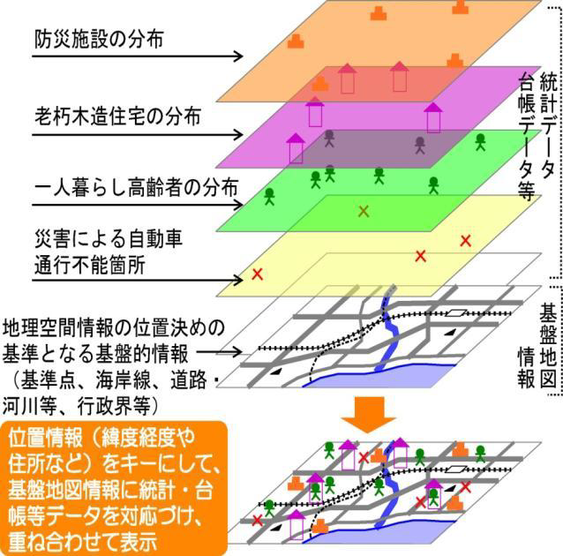
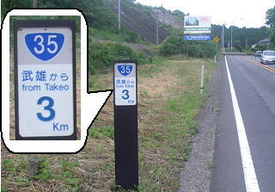
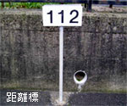

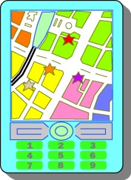


2 pillars of NSDI Act
Geospatial Information
Satellite Positioning
Fundamental Geospatial Data
Multi-GNSS Satellite Positioning
Disaster prevention facilities
Brittle houses
Residents who need supports
Collaboration
Blocked roads
Combine
Integrate
Analyze
Promote comprehensive application measures

Slide 7
Coordination among different sectors
National Government
Responsibility
Developing and carrying out comprehensive policies
Legal and other Measures
Taking legal, financial, and other measures
Enhancement of Liaison
Taking necessary measures to enhance the liaison
Local Governments
Responsibility
Developing and carrying out policies in harmony with the circumstances of their regions
Cooperation
Private Sector
Efforts
Providing high quality geospatial information
Cooperate with the State and/or local governments in their policies
Research Institutions
(Universities etc)
17

Slide 8
NSDI Steering Committee
NSDI Steering Committee
(Committee for
the Advancement of Utilizing Geospatial Information)
Chairperson: Deputy Chief Secretary
(parliamentary and administration)
Acting Chairperson: Assistant Deputy Chief Cabinet
Secretary
Members: Bureau directors in charge of each relevant
government agency
(Director-General of GSI , etc.)
Secretariat: Cabinet, Ministry of Land , Infrastructure ,
Transport and Tourism (National and
Regional Policy Bureau) , GSI
Geographic Information System Working Group
Satellite Positioning Working Group
Geospatial Project Promotion Working Group
Review Team
Promotion Team
○ on Protecting Personal information and intellectual Property
○ National Security
○ on Development and Update of Fundamental Geospatial Data
○ for Utilization of G-spatial Information Center
○ for Advancement of Disaster Prevention System
○ for IT-based Agriculture, Forestry and Fisheries
○ for Vitalization of Communities and Small and Mid-size Enterprises
○ for Overseas Development

Slide 9
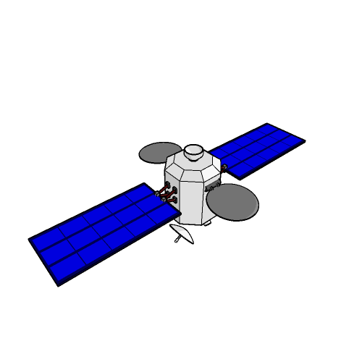
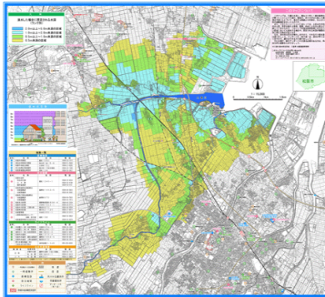
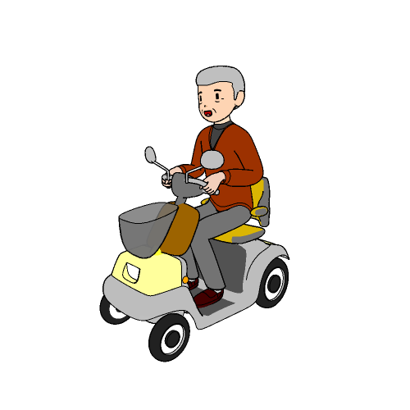


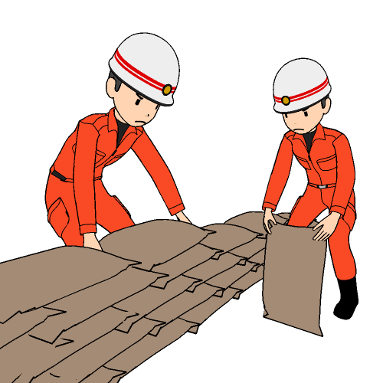

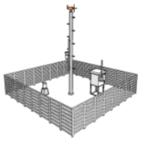


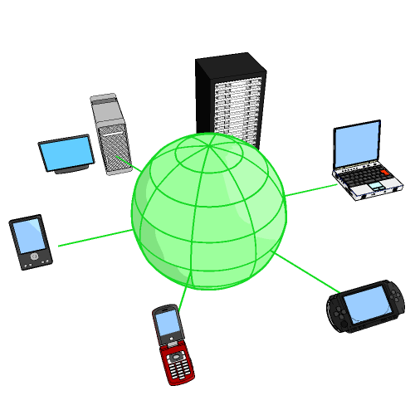
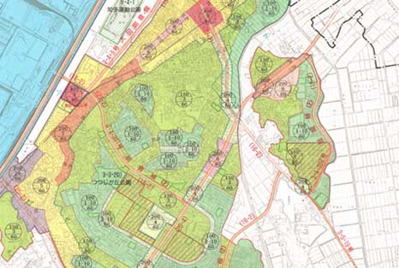




NSDI Basic Plan 2012-2016 – basic guidelines
Approaches that should be taken to materialize the Geospatial Society
“Anyone, anywhere, at any time” to use geospatial information and obtain accurate information based on high-level analyses for their daily activities.
Promoting the utilization, development, and preservation of land, and sustainable land-use that is highly resistant to disasters
Achieving high-quality, safe, and secure living
Creation of new services and industries
Promoting greater efficiency and quality of administrative services, and new public benefits

Slide 10
NSDI Basic Plan 2012-2016 - goals
The present plan contains project goals for 2012-2016, especially the following 4 foundations of work that should be undertaken to achieve a Geospatial Society
Goal #2
Goal #1
Satellite Positioning,
Navigation and Timing
Goal #4
Geographic Information System
Developing seamless geospatial information to meet society’s needs and applications to new uses
Domestic and overseas development and utilization of practical quasi-zenith satellite systems
Recovery from the Great East Japan Earthquake and contribution to sustainable
land-use that is highly resistant to disaster
Further permeation and establishment
of the geospatial information in society
Goal #3
Specific Measures to achieve the policies of the plan
Toward to the Geospatial Society

Slide 11
ownership
GSI broke down our contribution to NSDI into 3 components.
ownership and involvement matters, to implement NSDI.
NSDI
National Spatial Data Infrastructure
Geospatial Society
Various application by open innovation
Disaster Response as the Moment of Truth
(1) GNSS CORS Infrastructure
(2) Institutional Arrangement
(3) Web Maps
Geospatial Infrastructure
Open data service, often by open source software

Slide 12
involvement
We involve ourselves and our partners in:
Open Data
We follow the Open Data Policy of the Government of Japan (compatible with CC-BY)
In addition, Survey Act applies to core data.
Open Source
We use Open Source for lowering running cost and for promoting development of domain-specific applications.
We also develop open source software available at GitHub.
Open Innovation
We run a community of geospatial developers who use our data – GSI Maps Partner Network.
We participate in existing community events such as FOSS4G Tokyo/Kansai, Code for Japan Summit, and GitHub Universe.

Slide 13
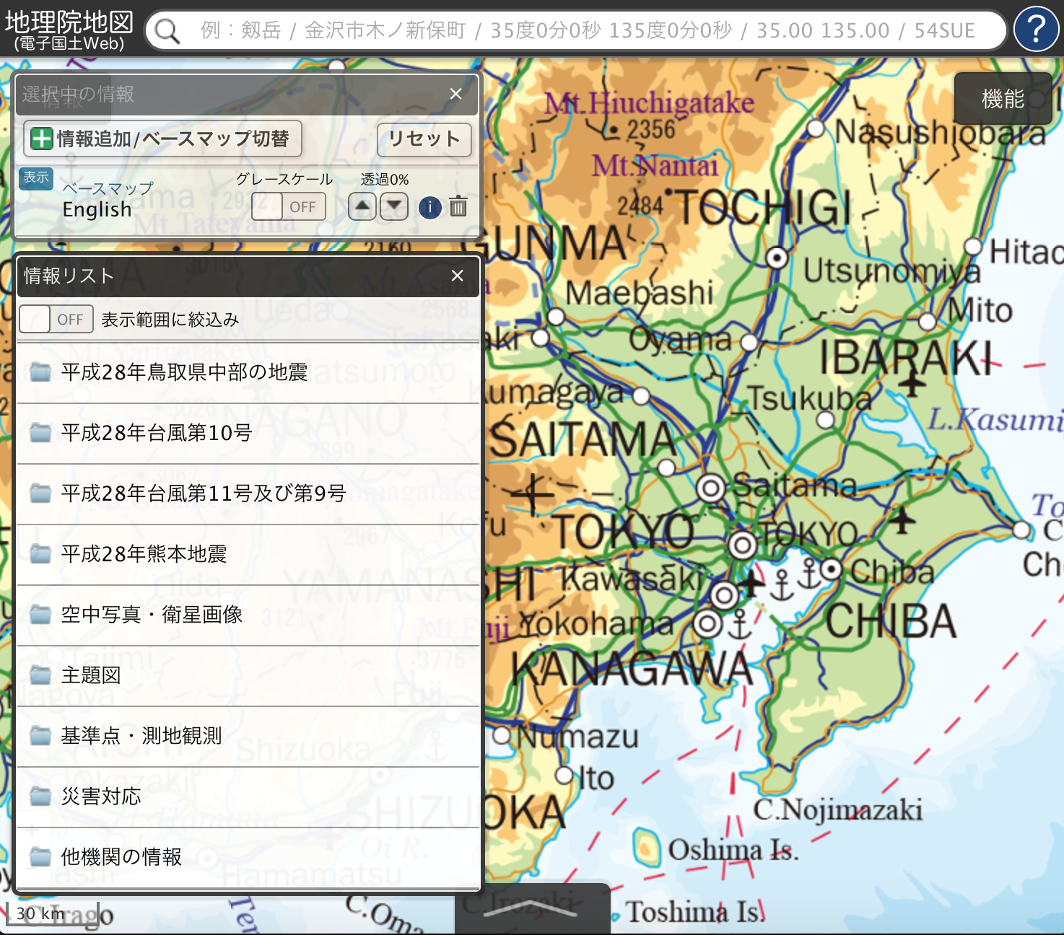
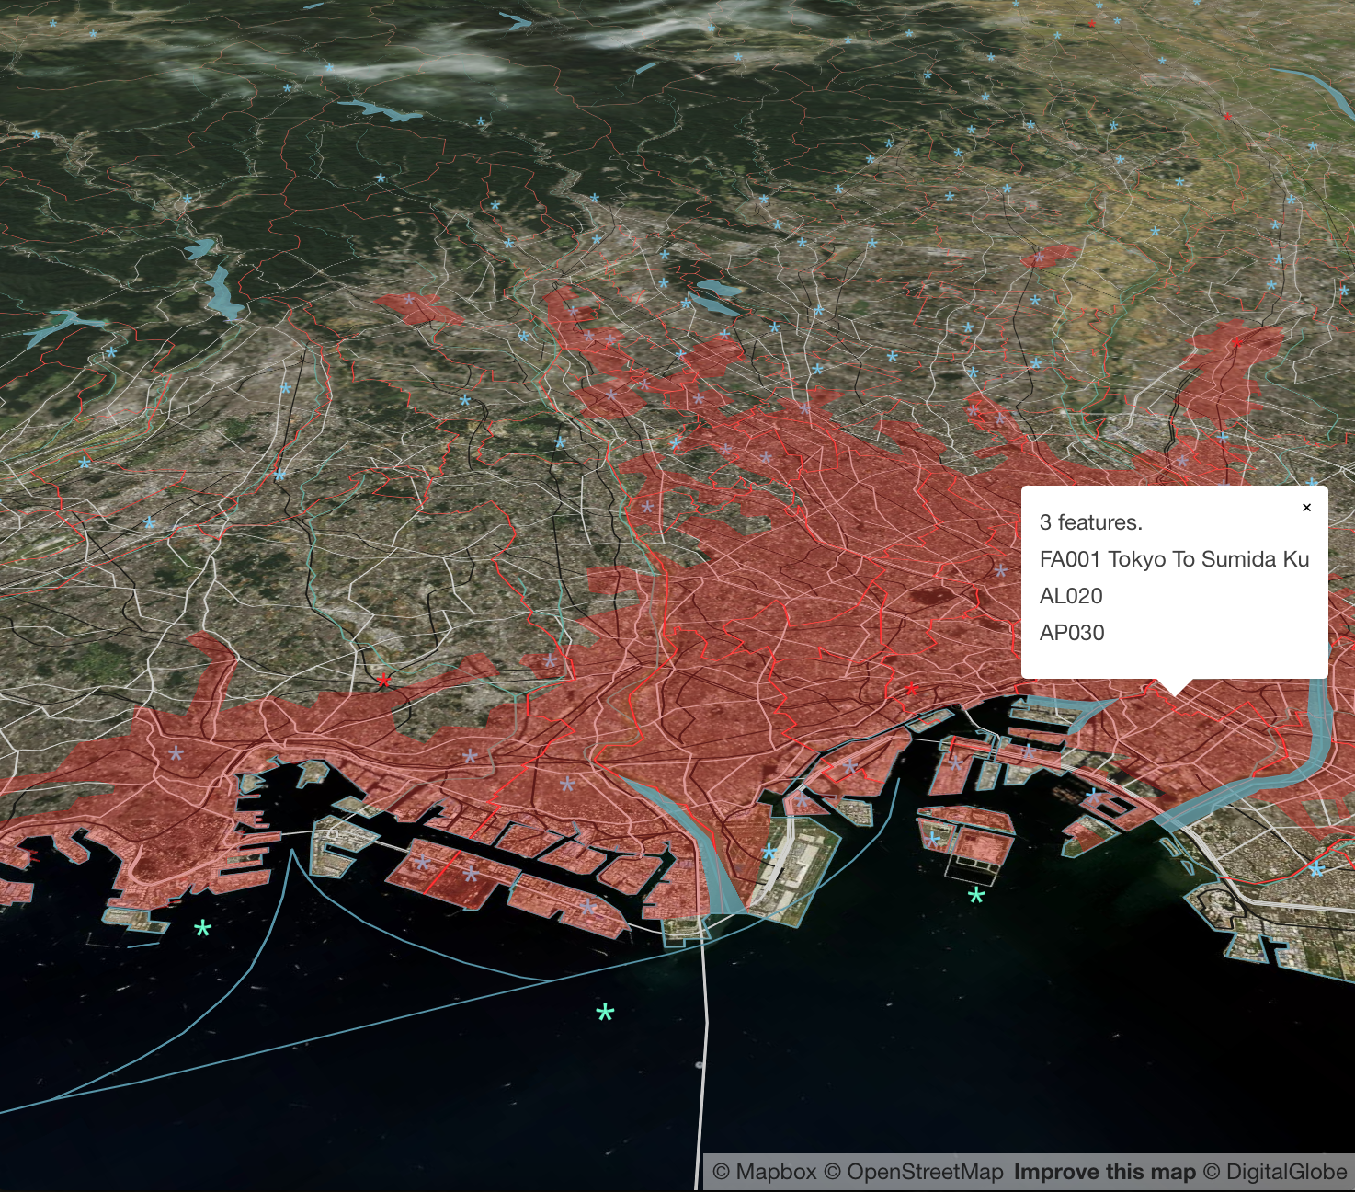
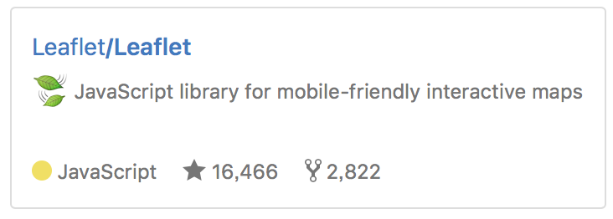


We import great open source software developed also in Ukraine
http://maps.gsi.go.jp/
Our geoportal “GSI Maps” provides approximately 1,600 layers as tiles or GeoJSON files.
http://bit.ly/tokyo-vt
Global Map data in binary vector tiles, to promote wider application (in development.)

Slide 14
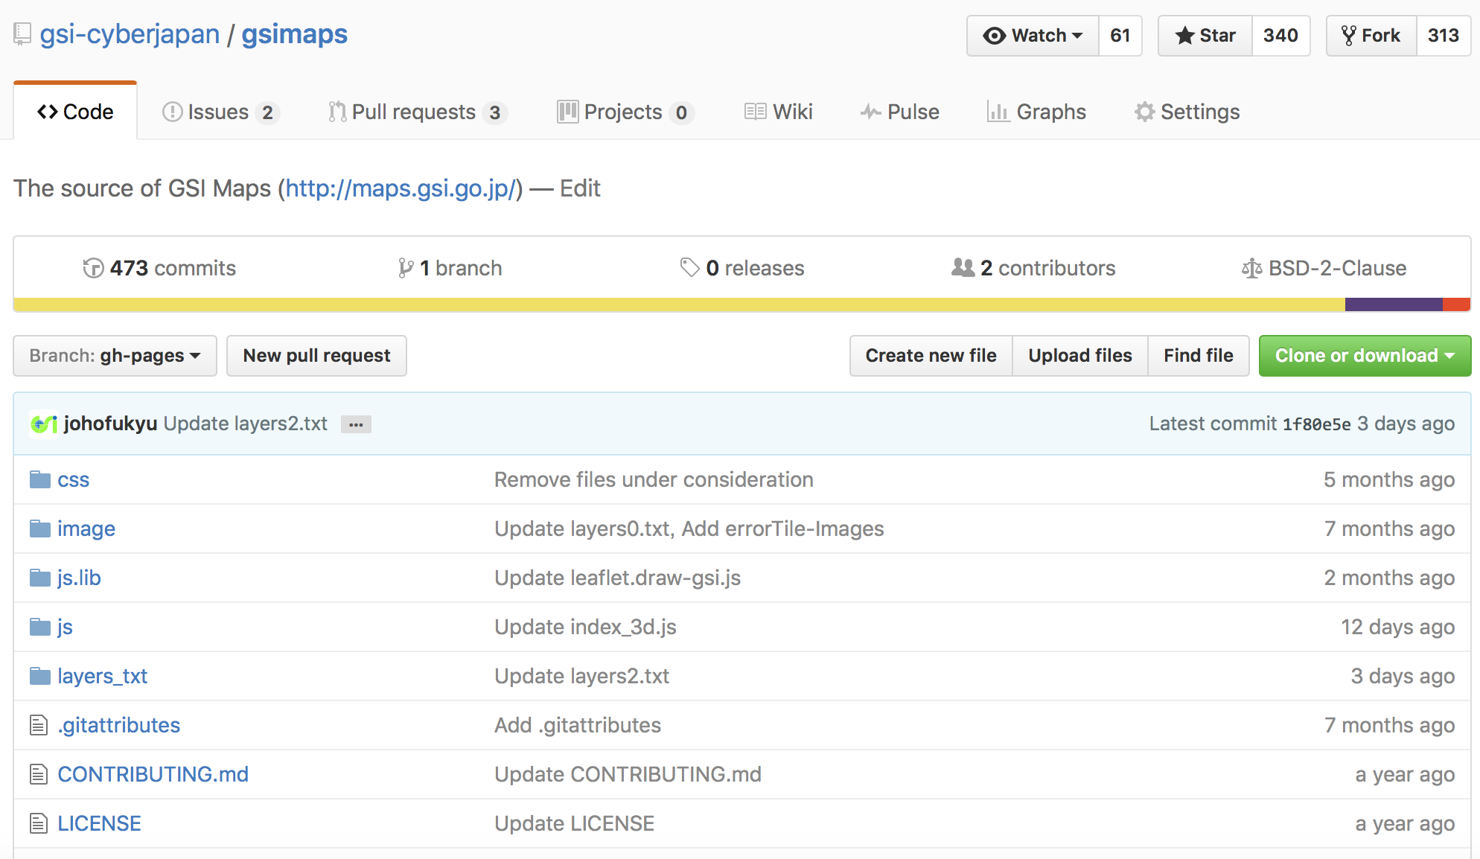
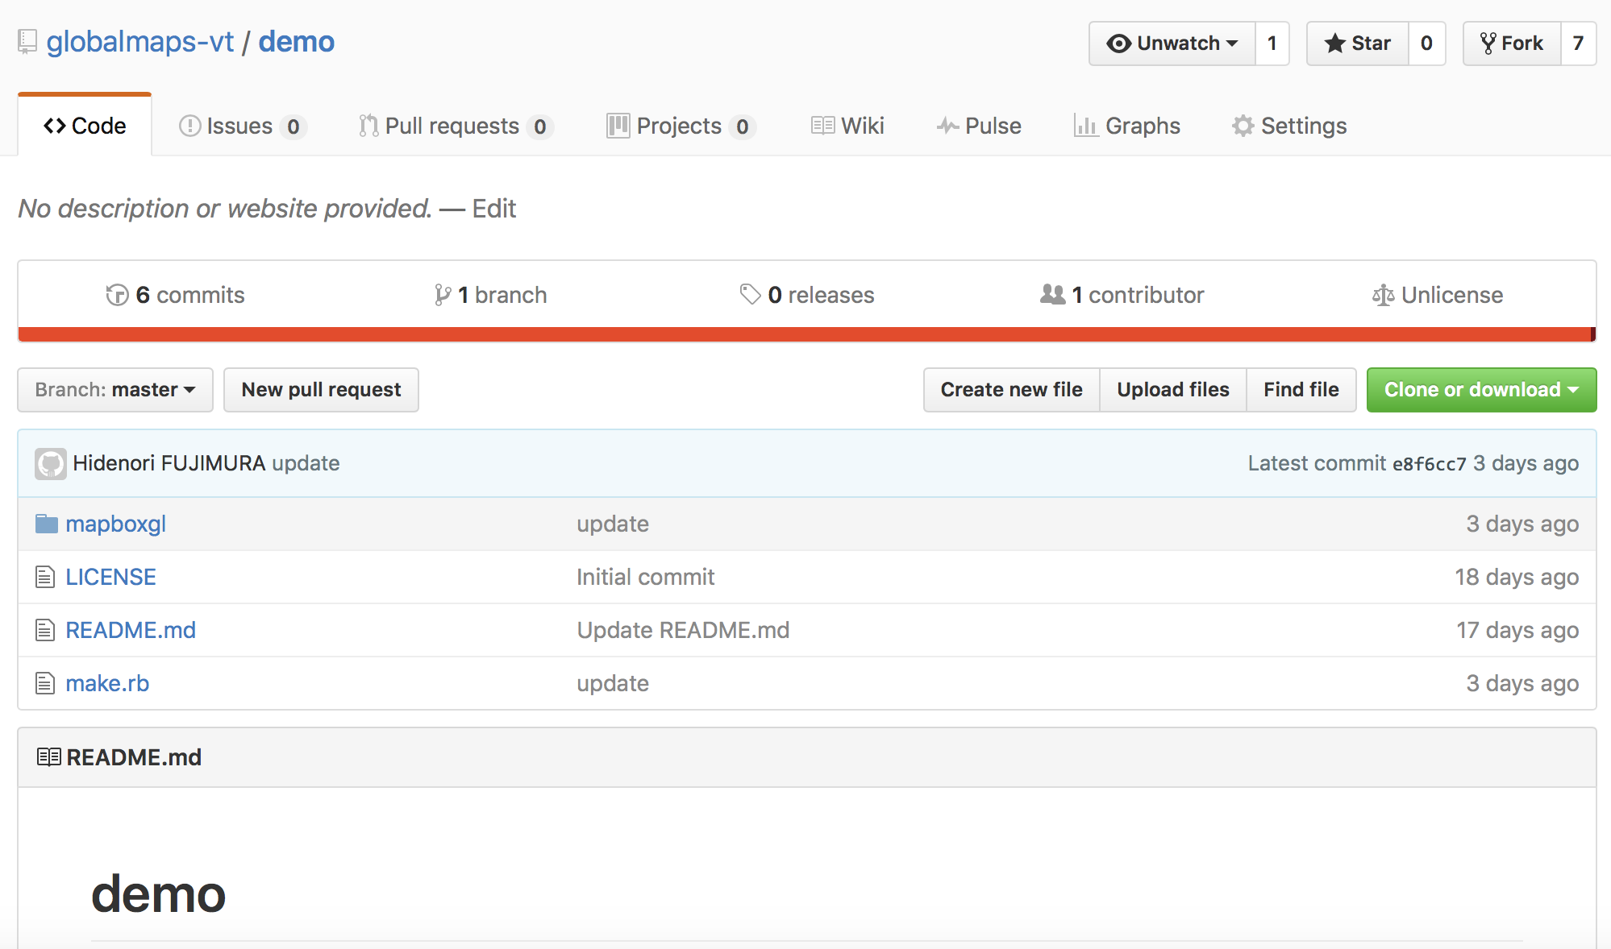
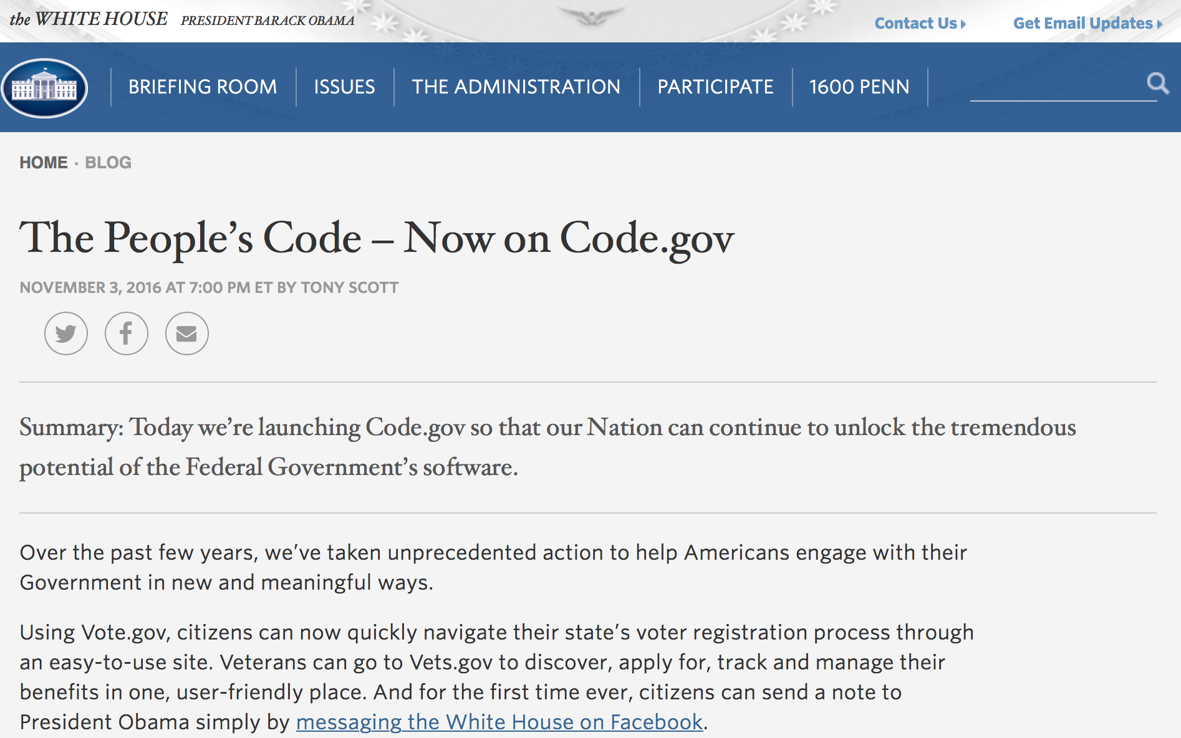
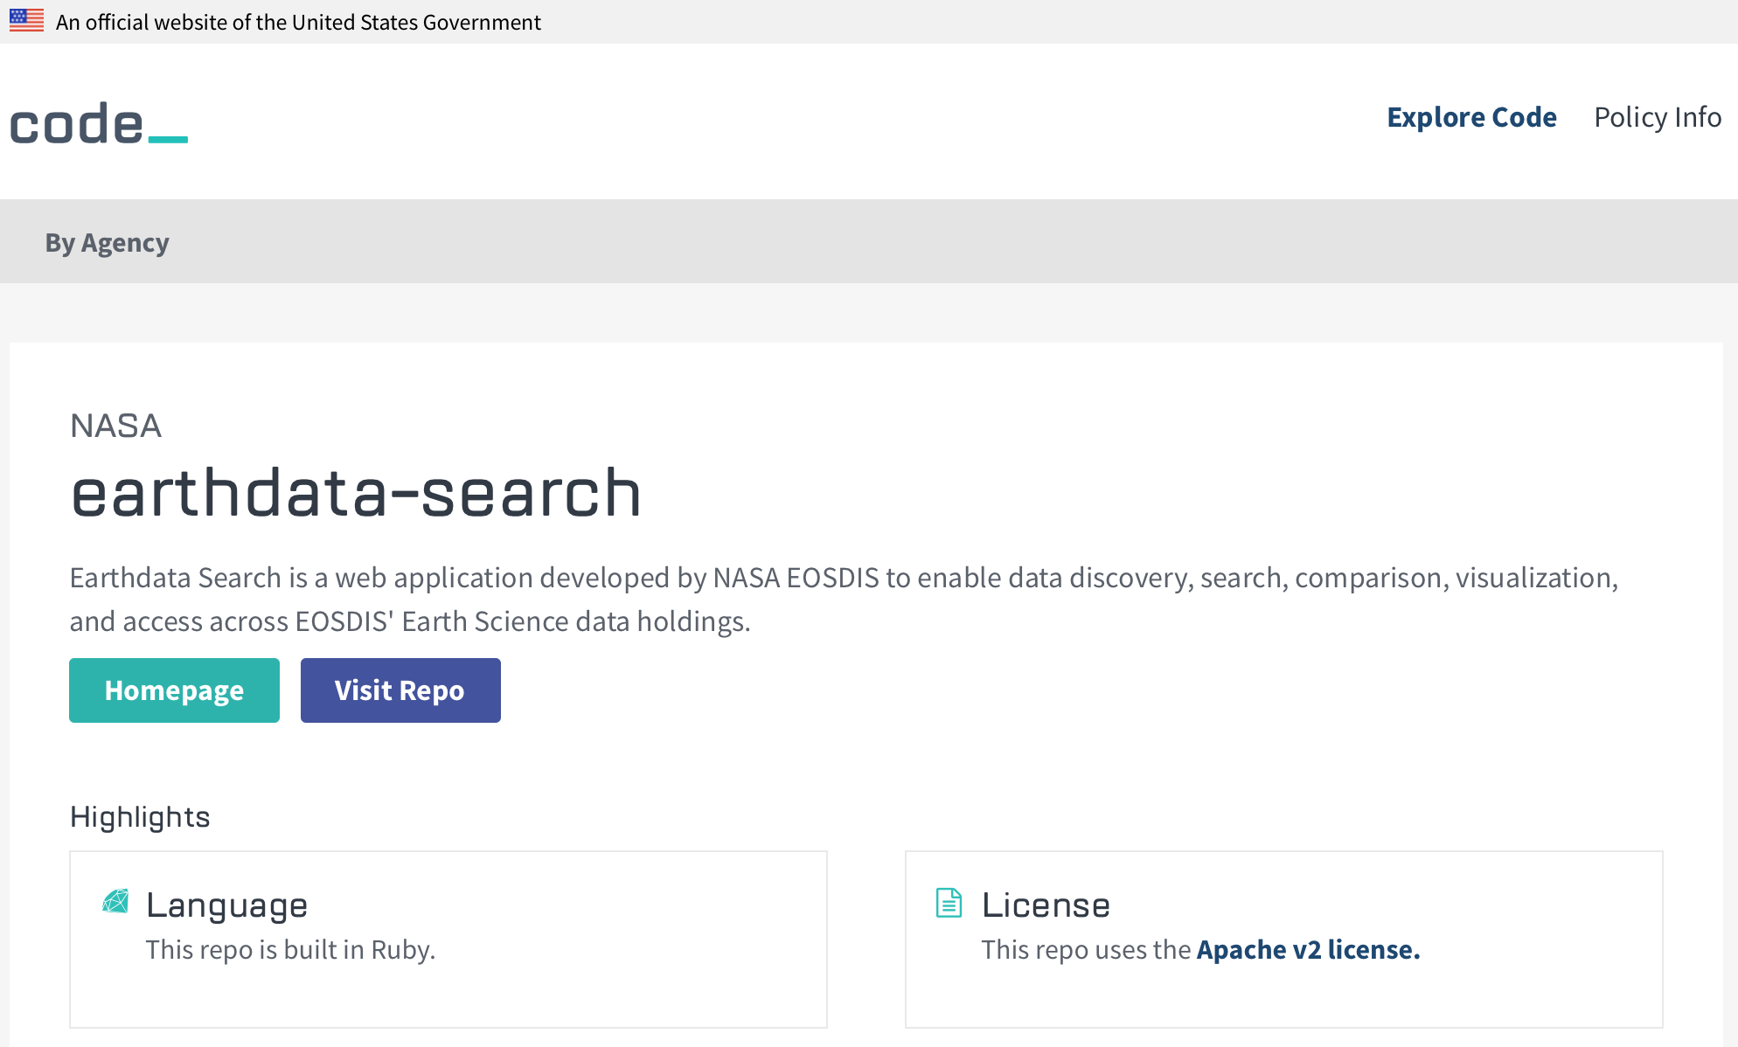
”code sharing” to promote governments’ work
https://github.com/gsi-cyberjapan/gsimaps
https://github.com/globalmaps-vt/demo

Slide 15
Summary
coordination
ownership
involvement
Let’s involve everyone and each other in order to catch up with technology trend, for wider and better application of our geospatial information.

